Slide 1

Pharma data analysis
Jyotirekha Das

Slide 2
1. Basic Filtering: Can you filter the data to show only the records for a specific country, let's say "United States"?
Ans. | There was no name "United States"
2. Sorting Data: How would you sort the data in ascending order based on the "Sales" column?
Ans. | By clicking on short on editing tool
3. Summarizing Data: What is the total quantity of all products sold in the year 2023?
Ans. | 28690162.8

Slide 3

4. Conditional Formatting: Apply conditional formatting to highlight all sales greater than $5,000 in the "Sales" column.
ANS.

Slide 4
5. Simple Pivot Table: Create a pivot table to summarize total sales by "Channel."
Ans. | Channel | Sum of Sales
 | Hospital | 5580678777
 | Pharmacy | 6218320452
6. Basic Chart: Generate a bar chart to visualize the sales quantity by "Product Class."
Ans. | Product class | Sum of Quantity
 | Analgesics | 5553143.784
 | Antibiotics | 4154321.857
 | Antimalarial | 4249075.25
 | Antipiretics | 4052544.057
 | Antiseptics | 5499912.713
 | Mood Stabilizers | 5169781.142
 | Grand Total | 28678778.8

Slide 5
7. VLOOKUP Function: Can you use the VLOOKUP function to find the "Manager" for a specific "Sales Rep"?
Ans. | Name of Sales Rep | Manager
 | Jessica Smith | Britanny Bold
 | Mary Gerrard | Britanny Bold
 | Erica Jones | James Goodwill
 | Alan Ray | James Goodwill
8. Data Validation: Set up data validation to allow only specific cities from a predefined list in the "City" column.
Ans. | City
 | Emden
 | Deggendorf
 | Konstanz
 | WeiÃŸenfels
 | Bad Neuenahr-Ahrweiler
 | Lehrte
 | Geldern
 | WÃ¼rselen
 | Kaiserslautern
 | Brandenburg
 | Bergkamen
 | Rinteln
 | Schwerin
 | Lehrte
 | Hattingen
 | Parchim

Slide 6
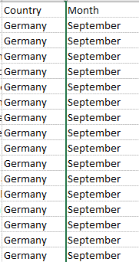
9. Advanced Filtering: Apply a filter to show records where "Product Class" is either "Electronics" or "Clothing."
Ans. | There was no product class named "Electronics" or "Clothing."
10. Sorting with Multiple Criteria: How would you sort the data first by "Country" in ascending order, and then by "Month" in descending order? ANS.

Slide 7
11. Calculated Fields in Pivot Table: Add a calculated field in the pivot table to calculate the average price per unit sold.
Ans. | Quantity | Average of Price
 | 42 | 378.7615894
 | 58 | 407.6
 | 73 | 362.625
 | 80 | 414.7996812
 | 81 | 448.75
 | 87 | 389.6
 | 88 | 410.1363636
 | 94 | 525.2941176
12. Advanced Charting: Create a line chart to show the trend of total sales over the years.
Ans. | Year | Sum of Sales
 | 2020 | 2701486690
 | 2021 | 3506899622
 | 2022 | 2930938723
 | 2023 | 2659674194

Slide 8
13. Nested IF Function: Use a nested IF function to categorize "Sales" into three categories: Low, Medium, and High.
Ans. | Sales
 | 15552 | Medium
 | 70200 | High
 | 70200 | High
 | 70200 | High
 | 9940000 | High
 | 70200 | High
 | 70200 | High
 | 15552 | Medium
 | -2433600 | Low
 | 4046 | Low
 | 15552 | Medium
 | 26904 | Medium
 | 70200 | High
 | 70200 | High
 | 70200 | High
 | 70200 | High
 | 70200 | High
 | 4046 | Low
 | 70200 | High
 | 4046 | Low

Slide 9
14. Data Validation with Dropdown Lists: Create dropdown lists for "Product Class" and "Sub-channel" in the data entry cells.
Ana. | Product Class | Sub-channel
15. Pivot Chart: Turn the pivot table created earlier into a pivot chart to visualize sales by "Distributor."
Ans. | Distributer | Sum of Sales
 | Bashirian-Kassulke | 349340733
 | Beier | 150834384
 | Carter-Conn | 7254859
 | Cassin | 58656142
 | Crist Inc | 45056505
 | Daugherty-Rempel | 232130563
 | Erdman | 1522611112
 | Gerlach LLC | 3501836965
 | Gleason | 138618744
 | Gottlieb-Cruickshank | 47975896
 | Graham and Sons | 15408356
 | Hansen Group Pharm | 1171856
 | Koss | 3087830203
 | Kozey-Emmerich | 1232932589
 | Kris LLC | 1307176
 | Lesch | 13543969
 | Lindgren-Simonis Pharm | 17893212
 | Lockman | 95983327
 | Nader-Gaylord | 27092064
 | Prohaska-Kuhic | 81980617
 | Rogahn-Klein | 7137098
 | Rohan | 31745787
 | Rohan and Sons | 142512299
 | Romaguera-Fay | 444992535
 | Schaefer LLC | 21830187
 | Schuppe Inc | 12624284
 | Smith Inc | 119547357.8
 | Stehr-Champlin | 128514906
 | Welch-Langworth | 260635503

Slide 10
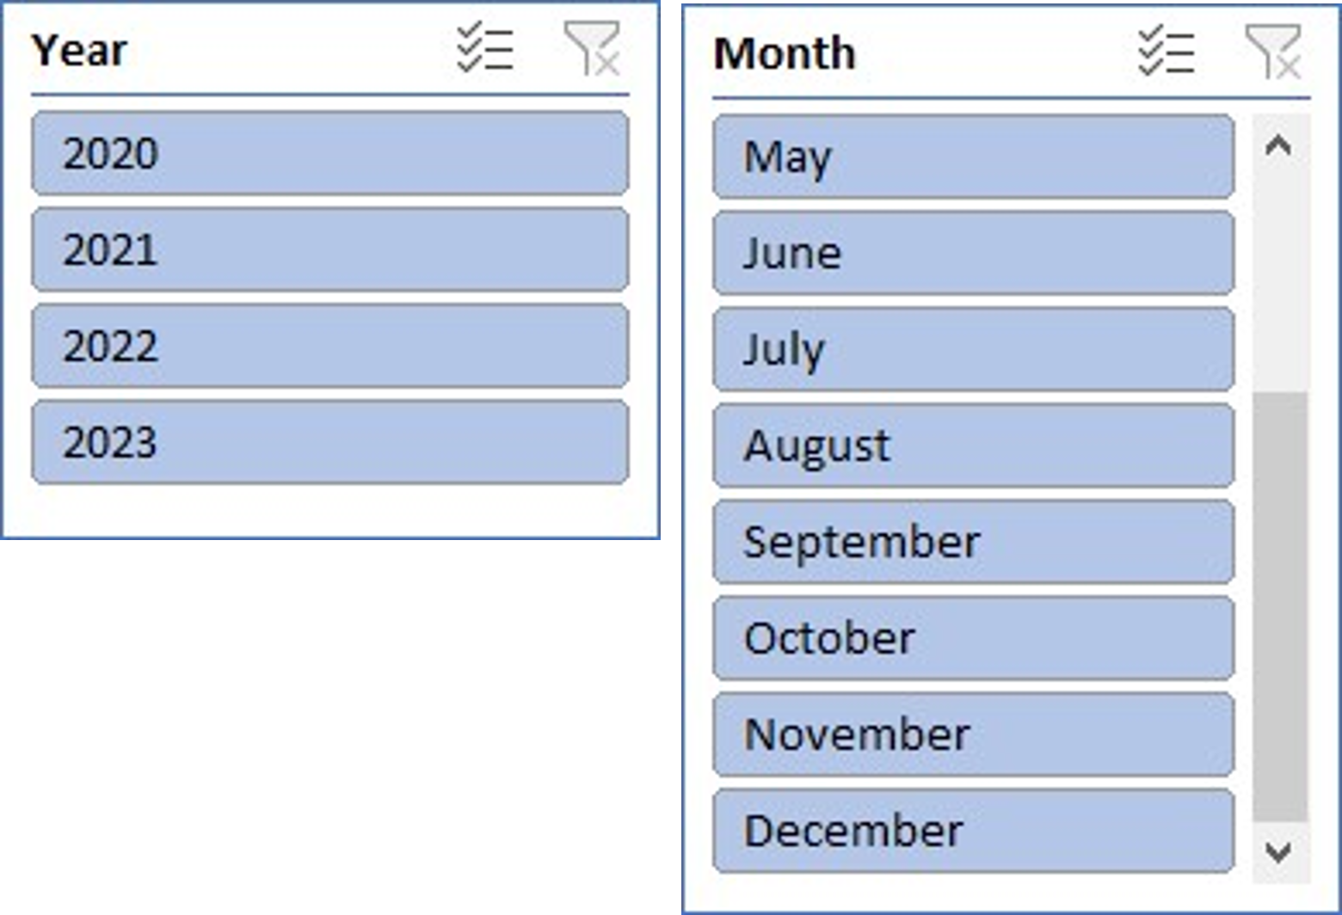
16. Pivot Table Slicers: Add slicers to the pivot table to allow easy filtering by "Month" and "Year."

Slide 11
17. Lookup Functions: Use INDEX and MATCH functions to find the "Sales Rep" for a specific "Customer Name."
Ans. | Alan Ray
18. Advanced Conditional Formatting: Apply a custom conditional format to highlight the top 10% of sales values with a distinct color.
Ans. | (=)M2>PERCENTILE($M$254083, 0.9)

Slide 12
19. Scenario Manager: Use the Scenario Manager to compare different scenarios for future sales by changing variables like "Price" and "Quantity."
Scenario Summary
 |  | Current Values: | Scenario 1 | Scenario 2
Changing Cells:
 | $K$2 | -1920 | -1920 | -1920
 | $L$2 | 686 | 686 | 686
 | $K$3 | -1832 | -1832 | -1832
 | $L$3 | 404 | 404 | 404
 | $K$4 | -1000 | -1000 | -1000
 | $L$4 | 678 | 678 | 678
 | $K$5 | -1288 | -1288 | -1288
 | $L$5 | 472 | 472 | 472
 | $K$6 | -827 | -827 | -827
 | $L$6 | 618 | 618 | 618
 | $K$7 | -1000 | -1000 | -1000
 | $L$7 | 511 | 511 | 511
 | $K$8 | -1000 | -1000 | -1000
 | $L$8 | 502 | 502 | 502
 | $K$9 | -630 | -630 | -630
 | $L$9 | 582 | 582 | 582
 | $K$10 | -470 | -470 | -470
 | $L$10 | 778 | 778 | 778
 | $K$11 | -1000 | -1000 | -1000
 | $L$11 | 345 | 345 | 345
 | $K$12 | -932 | -932 | -932
 | $L$12 | 370 | 370 | 370
 | $K$13 | -700 | -700 | -700
 | $L$13 | 472 | 472 | 472
 | $K$14 | -1152 | -1152 | -1152
 | $L$14 | 243 | 243 | 243
 | $K$15 | -680 | -680 | -680
 | $L$15 | 304 | 304 | 304
 | $K$16 | -300 | -300 | -300
 | $L$16 | 578 | 578 | 578
 | $K$17 | -300 | -300 | -300
 | $L$17 | 535 | 535 | 535

